Slide 1
Word Cloud 2021.4.3

Slide 2
1.facility
2.engine
3.insect
4.debate
5.gym
6.dinosaur
7.dolphin
8.journal
9.rate
10.committee
11.select
12.neat
13.specific
14.former
15.memorise
1.stage
2.sharp
3.present
4.band
5.explore
6.figure v.
7.figure n.
8.sight
9.gain
10.struggle

Slide 3
1.curious→n.
2.impress→adj.
3.eager→n.
4.organize→adj
5.challenge→adj
6.argue→n.
7.sharp→vt
8.various→n.
9.apply→n.
10.graduate→n.
11.improve→n.
12.enjoy→adj
13.embarrass→n.
14.disappoint→n.
15.explore→n.
1.curiosity
2.impressive.
3.eagerness.
4.organized
5.challenging
6.argument.
7.sharpen
8.variety.
9.application.
10.graduation.
11.improvement.
12.enjoyable
13.embarrassment.
14.disappointment.
15.exploration.

Slide 4
16.describe→n.
17.breathe→n.
18.manage→n.
19.instruct→n.
20.panic( , )
1.给某人留下好的第一印象
2.向我们强调英语的重要性
3.难以形容的
4.使某人有压力
5正要做某事…突然…
6.去了解我们的新学校
7.在脑海中一遍遍想象…
8.冲出教室
9.（做事前）紧张忐忑
10.记录…

Slide 5
11.白费口舌
12.详细描述下你的旅程
13.做某事有困难
14.设法做成某事
15.refer to
16.care about/care for
17.take up
18.in particular
19.与某人就某事争论
20.给…拍照
21.依靠，信赖，取决于
22.对未来充满自信
23.apply to
24.如果必要的话
25.一次只做一件事

Slide 6
26.按重要性顺序排列
27.keep an open mind
28.hold up
29.我完全同意
30.结束…
31.比…年长/级别高
32.睡得很熟
33.不遗余力的去
34.回顾，回忆
35.他害怕的神情
36.按时，如期

Slide 7
1.move→n.
2.transform→n
3.universe→adj
4.energy→adj
5.emotion→adj
6.anger→adj→adv
7.combine→n.
8.explode→adj
9.applaud vt&vi→n.
10.discourage→adj/n
11.absorb→adj→n.
12.romance→adj
13.appeal→adj
14.definite→adv→n.
15.rude→adv→n.

Slide 8
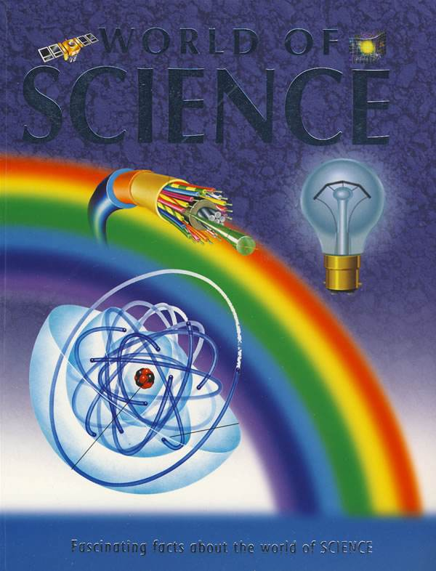
Unit 3

Slide 9
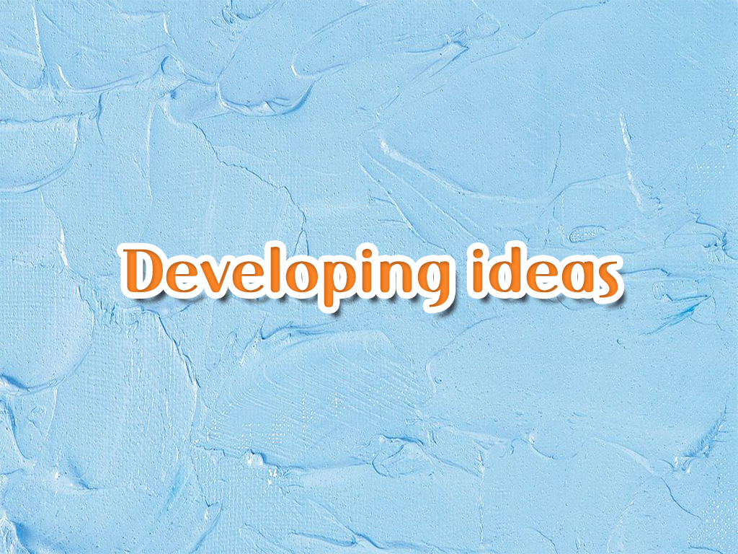

Slide 11

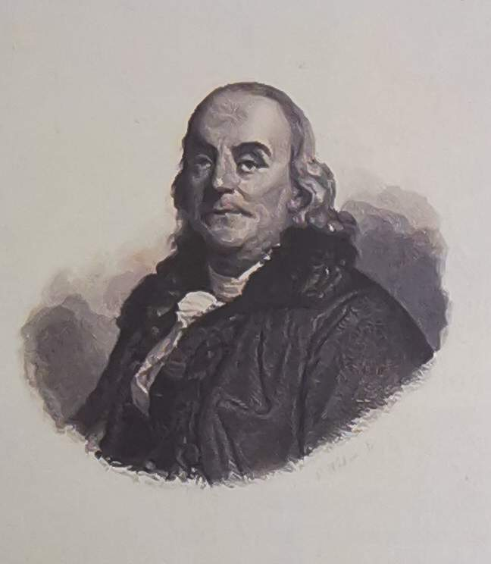
1. Read the short introduction to Benjamin Franklin and share any other information you know about him.
Benjamin Franklin(1706-1790)was one of the Founding Fathers of the United States and helped draft the Declaration of Independence. Apart from being a successful statesman, he was also well known as a leading American author, printer and publisher, successful diplomat, creative scientist and inventor.

Slide 12
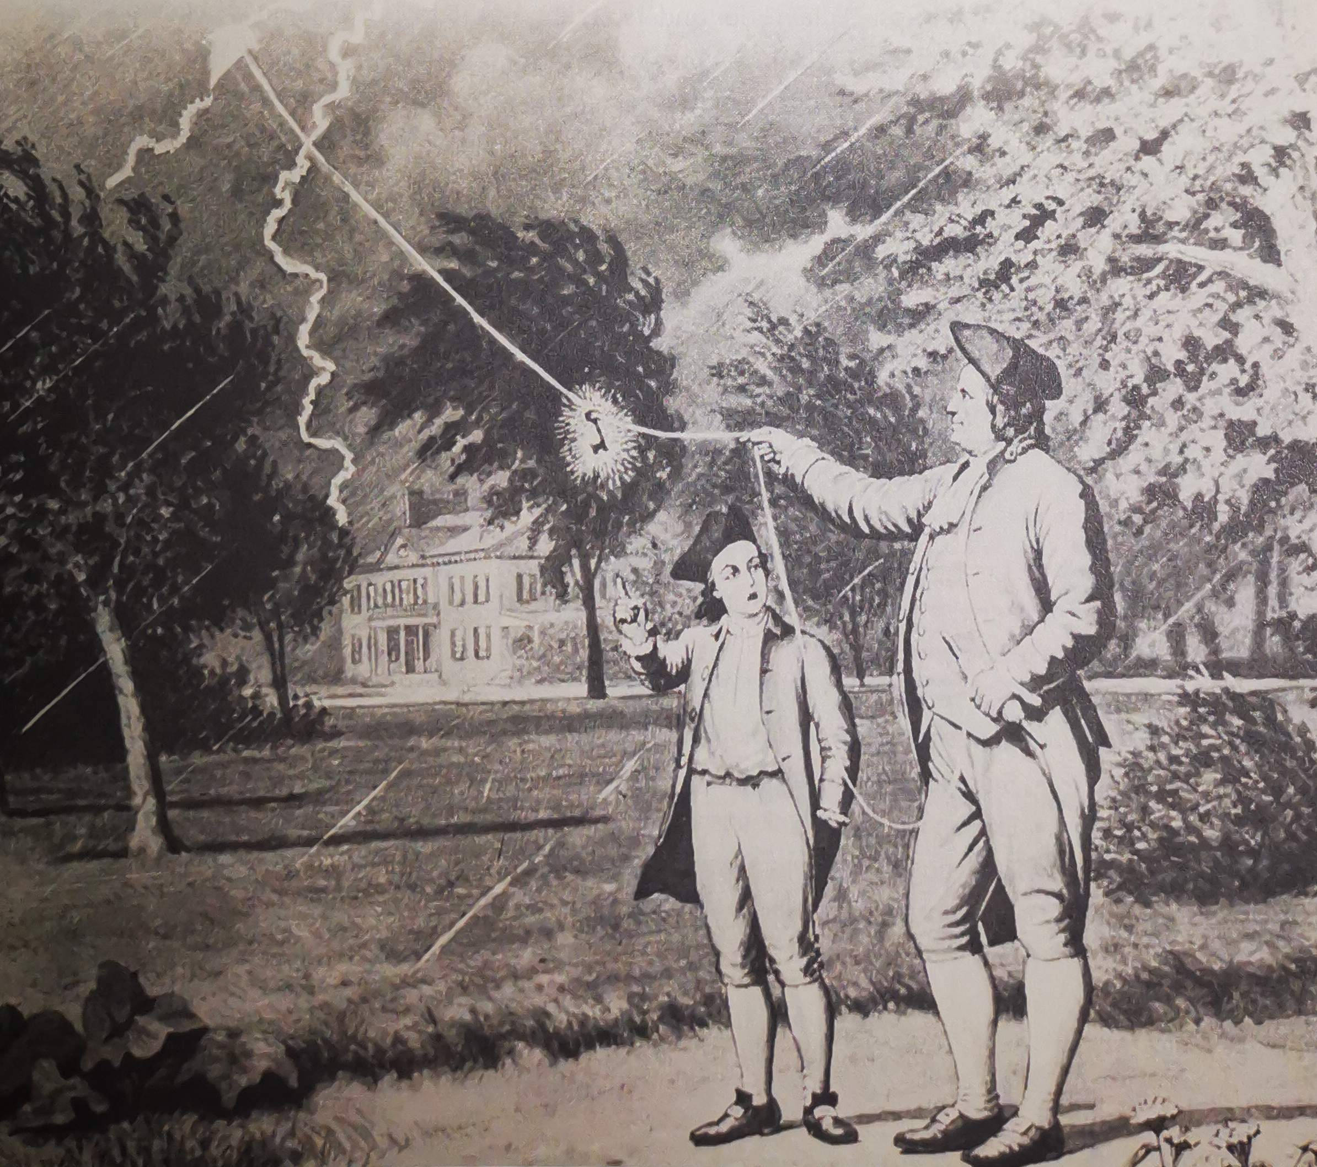
Franklin’s Experiment：
How much is ture?

Slide 13

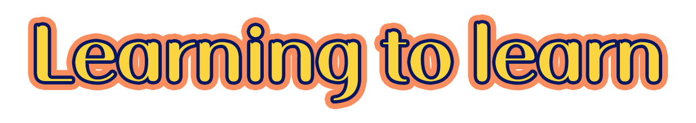
What’s the function of an essay title?
An essay title often contains an explicit or implicit question which your essay should focus on answering. For example, the title “Franklin’s Experiment: How Much Is True?” makes it clear what question is being answered within the essay.
So if there is a title, we’d better read it first to get to know the main idea of the passage.

Slide 14


Read the passage and find out what
Franklin’s experiment aimed to prove.
It was conducted to prove that lightning was a form of electricity.

Slide 15

1) Do you think it matters that Franklin’s
experiment might not be true? Why?
2) In what ways do scientists contribute to
society?
3) Explain your understanding of the saying “Seeing is believing”,

Slide 16
V
Language points

Slide 17
Language Points: Important phrases
1. apart from
2. experiment with
3. fly a kite
4. a flash of lightning
5. get an electric shock
6. establish the truth/fact
7. admittedly
8. Seeing is believing
______________________
______________________
______________________
______________________
______________________
______________________
______________________
______________________
除…以外
用/以…做实验
放风筝
一道闪电
受到点击
确定事实
无可否认
眼见为实

Slide 18
Language Points: Important sentences
Benjamin Franklin’s famous experiment with lightning has introduced generations of children to science. However, new research suggests that the story may be fiction instead of fact.
introduce sb to sth使某人初次了解/体验…
eg. 这次校园书展让学生们初次感受到阅读的乐趣。
The book fair introduced the students to the
pleasure of reading.

Slide 19
Language Points: Important sentences
2. He raised the kite with a piece of string tied to it. A metal key was attached to the string.
attach vt 绑，系，贴上； 附上
eg. I attach a copy of my notes for your information.
eg.Don't forget to attach a recent photograph to
your application form.
be attached to…
eg. This primary school is attached to Beijing Normal University.
eg. She is very attached to her family and friends.
attachment n.附件，附属物，依恋

Slide 20
Language Points: Important sentences
3. A flash of lightning hit the kite, and electricity was conducted through the string to the key.
昨天城里下了一场大雪，交通阻塞了。
eg. A big snow hit/struck the city yesterday , helding up the traffic.
conduct vt
eg. to conduct an experiment/an inquiry/a survey
eg. Dennis had recently begun a successful career conducting opera in Europe.
eg. The guide conducted us around the ruins of the ancient city.
conductor n. 导体，售票员，乐队指挥

Slide 21
Language Points: Important sentences
4. Franklin, along with many other scientists, has inspired us and taught us that…….
就远原则：
当主语后跟由but, except, besides, including, like, with, as well as, as much as, no less than, along with, in addition to, combined with, rather than, together with等引出的短语时，谓语动词习惯上要与这些结构前面的主语保持一致(即与比较远的那个主语保持一致)。
eg.Nobody but two students is in the classroom.
eg.A woman with two children has come.
eg.The son, as well as his parents, wants to go there.
eg.John, rather than his roommates, is to blame.

Slide 22
Language Points: Important sentences
就近原则：
也称“邻近原则”“就近一致原则”，即:谓语与靠近的名词、代词(有时不一定是主语)在“人称、数”上一致。
eg.Neither you nor I am wrong .
eg. Not you but your father is to blame.
eg. There is a pen and some books on the desk.

Slide 23
Language Points: Important sentences
5.1)More than one generation of schoolchildren has been amazed by his bravery and his scientific approach to looking for the truth.
2) More than one scientist has questioned what really happened.
3)In fact , more than one account suggests that while Newton was …..
more than one /many a +n单+v单
eg.Many a mother tries to act out her unrealized dreams through her daughter.

Slide 24
Language Points: Important sentences
6. In fact, more than one account suggests that while Newton was certainly inspired by a falling apple, there is no proof that it hit him on the head.
account n&v
eg: I don't have a bank account,but I will open one.
eg. She gave the police a full account of the incident.
eg. She retired early on account of a serious disease.
eg. The company takes account of environmental issues wherever possible.
复习 account for…
eg.Yao Ming is the living proof that people can make their dream come true.

Slide 25
6. In fact, more than one account suggests that while Newton was certainly inspired by a falling apple, there is no proof that it hit him on the head.
动词+sb+介词+the +身体部位
eg.hit him in the face/on the nose/in the stomach
eg.seize/pull him by the arm
eg. take me by the hand
eg.lead the cow by the nose

Slide 26


